Slide 1


The Rhetoric of Death in Central Appalachia from Mid-19th Century to Early 20th Century: a Case Study in Teaching and Researching Rhetorical History
Amy Clark, Ph.D.
Chair of Communication Studies
Co-Founding Director, Center for Appalachian Studies

Slide 2
Part I: Understanding Rhetoric and Its Role in Material Culture

Slide 3
What is Rhetoric?
(Stoner & Perkins, 2005)
Public
Purposeful
Includes either verbal or nonverbal symbols (or both)
Created with the intention of persuading
Strategic

Slide 4
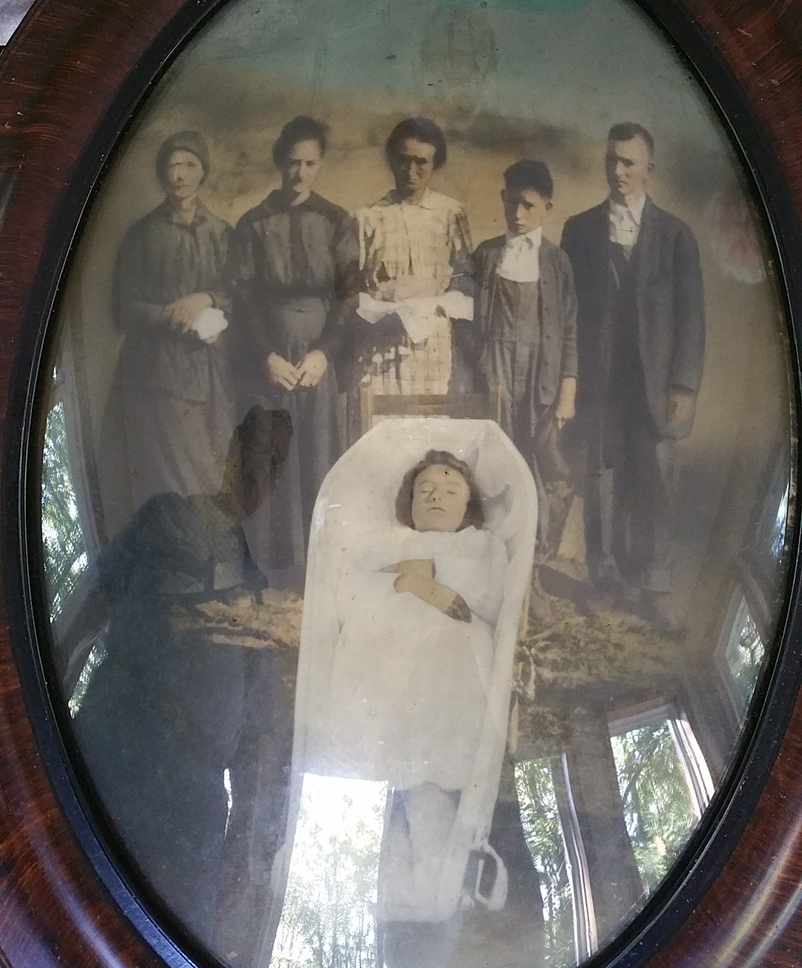
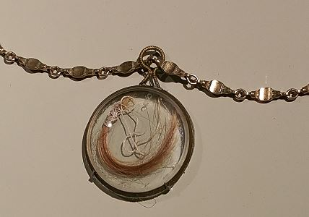
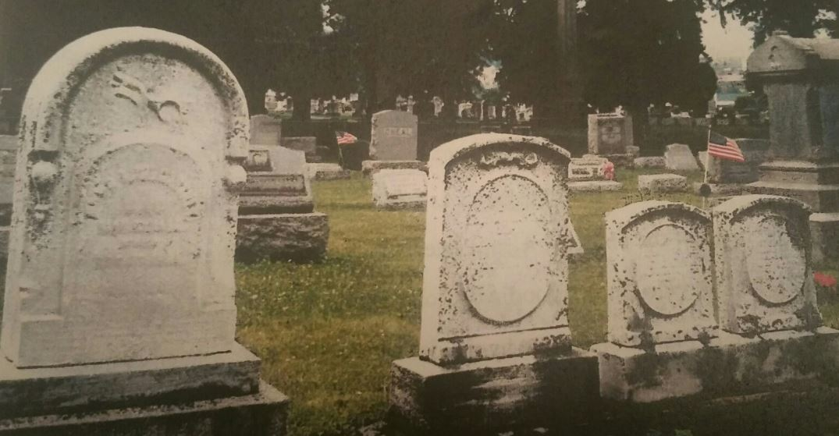
Material culture is the study of the beliefs and values of a particular culture at a given time using artifacts (Prown, 2008, p.1)
Semiotics is the study of how semantic and syntactic symbols or codes govern how we move through our lives, as we decode or make meaning.
Using these allied disciplines and modes of investigation, we can see how cultural objects associated with the rituals of death and grief are rhetorical by examining them as messages for the living.

Slide 5
Rhetorical Messages in Traditional Gravestones
Codes enable people to understand and process death and grief (the color black, symbols on graves, and rituals of burial and memory (Gordon, 2014.)
These codes are situated in the time and space they are created, but interpreted in differing contexts of time and space.
The cemetery is a cultural landscape where social trends are illustrated in a timeline of messaging decade after decade, century after century

Slide 7
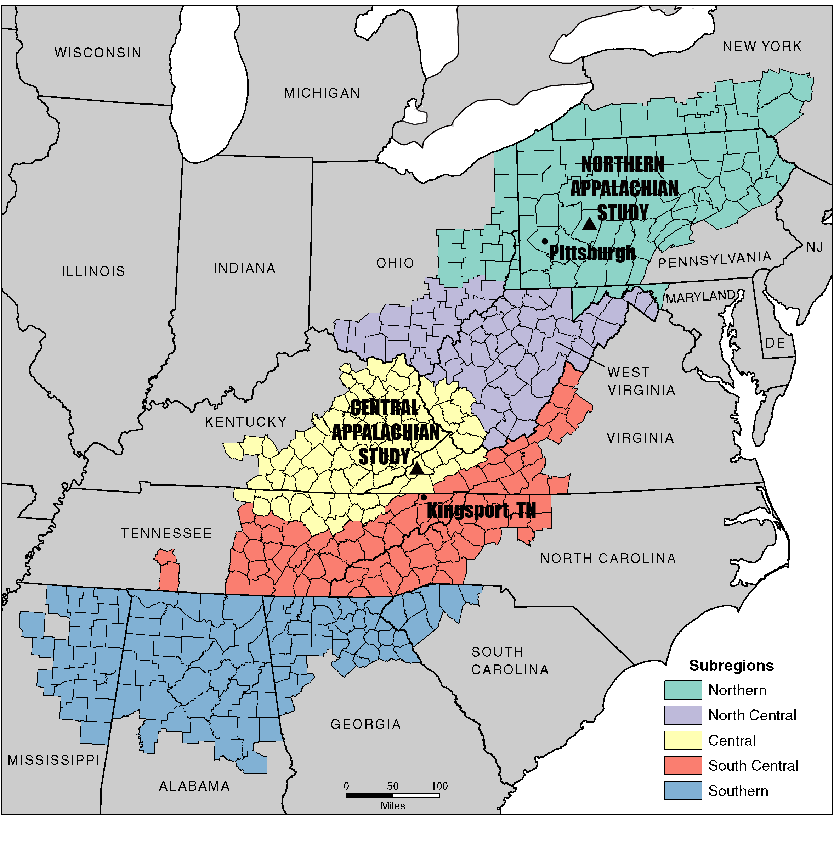
Sites of studies in Northern and Central Appalachia
Two studies will be discussed in this seminar
Appalachian Regional Commission, 2019

Slide 8
Context
Appalachian Region is 900 miles long, following the topography of the mountain chain along the eastern U.S.
Southernmost, central, and northern regions
Wood and fieldstone mark the oldest graves
Industrialization brought stonemasons who worked with limestone, siltstone, sandstone, granite, marble
Wars and illness populated and expanded Appalachia’s cemeteries
Shift to granite mausoleums and obelisks among the wealthy in the 19th century
Large Protestant population; religious beliefs reflected in iconography and epitaphs
Cemeteries reflect the values of those in the community who hold the most power

Slide 9
References for Part I
Gordon, A. (2014). The new semiotics of death. Retrieved from:
https://www.aqr.org.uk/a/20140301-newsemiotics
Prown. J.D. (2008). Mind in matter: An introduction to material culture theory and method.
Winturther Portfolio 17(1), 1-19. https://www.jstor.org/stable/1180761
Stoner, M. & Perkins, S.. (2005). Making Sense of Messages: A Critical Apprenticeship in Rhetorical Criticism. 10.4324/9781351130127. Retrieved from https://www.researchgate.net/publication/270904809_Making_Sense_of_Messages_A_Critical_Apprenticeship_in_Rhetorical_Criticism/citation/download

